Slide 1
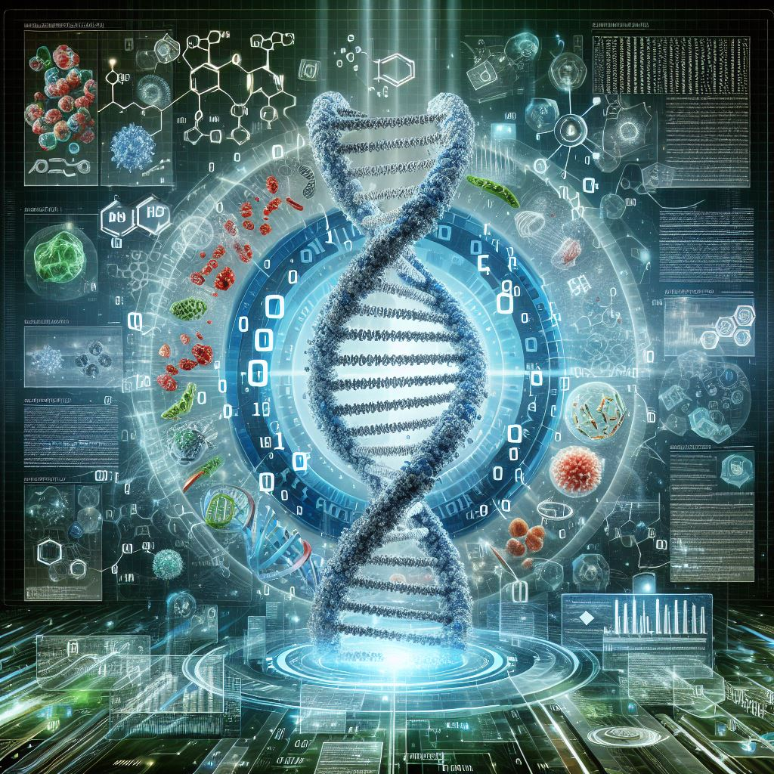


The Data Backbone of Modern Biology: An Overview of Bioinformatics Resources
Dr. Asha Vijayan
Assistant Professor(Sl.Gr.)
10-06-2025
mindbrain@amrita.edu

Slide 2
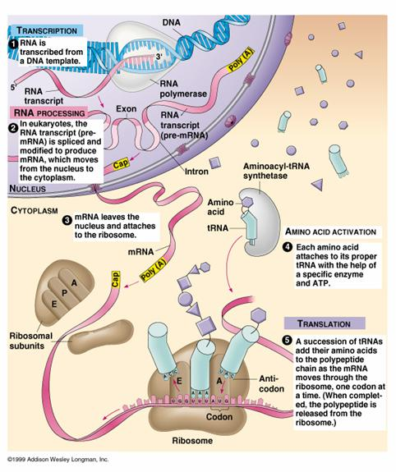
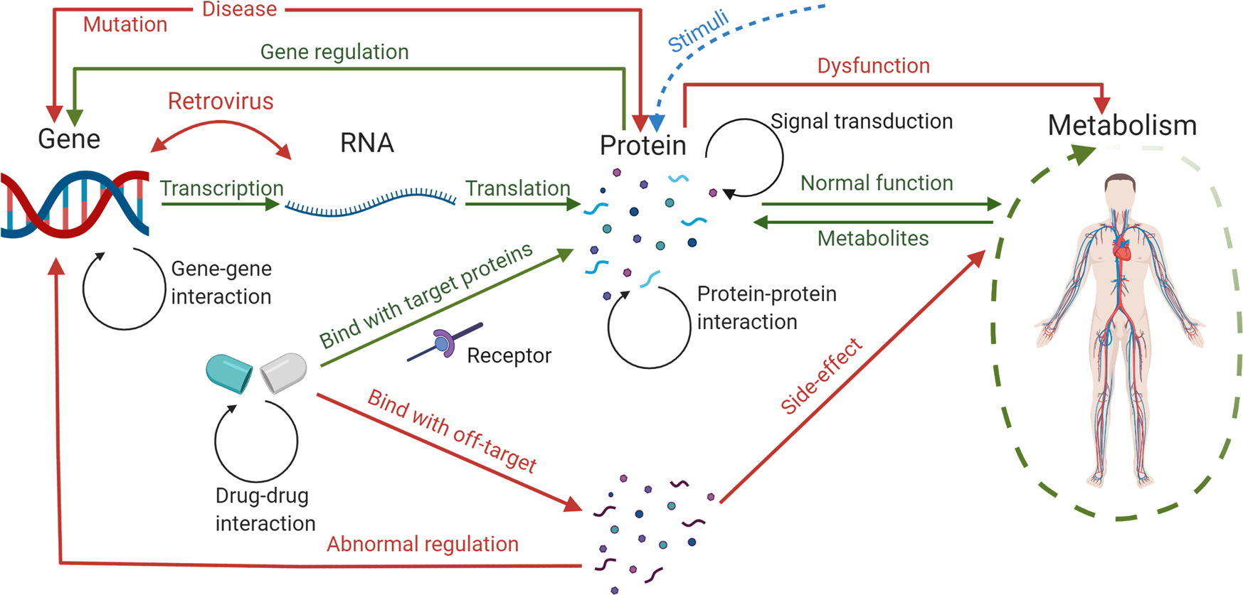
Central Dogma in the Data Age: From Genes to Proteins in a Digital Framework
Yue, R., Dutta, A. Computational systems biology in disease modeling and control, review and perspectives. npj Syst Biol Appl 8, 37 (2022). https://doi.org/10.1038/s41540-022-00247-4

Slide 3
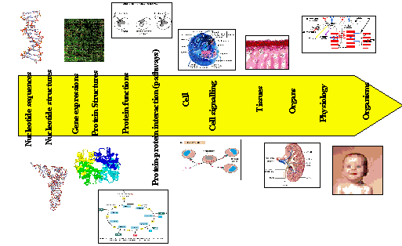
Complexity of biological data

Slide 4
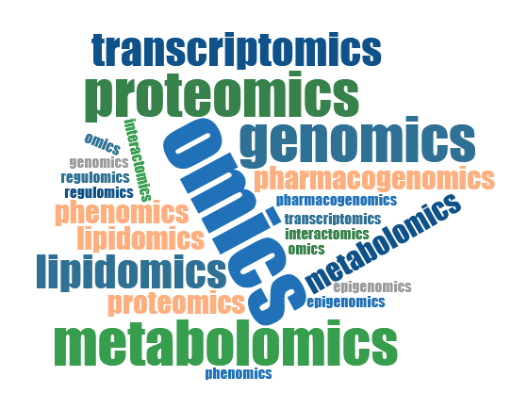
Understanding biological complexity
Complexity
Genotype
RNA
Protein
Metabolite
DNA
Flux
Phenotype
Omics
Transcriptomics
Proteomics
Metabolomics
Fluxomics
Epigenomics
Genomics
Phenomics
https://www.researchgate.net/publication/312004366_Nanoarchitectonics_A_navigator_from_materials_to_life/figures?lo=1

Slide 5
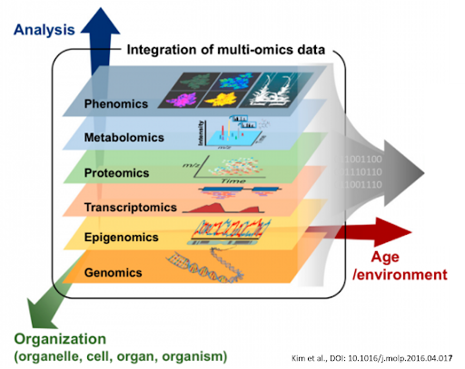
Omics
Cytomics: cellular systems in one organism
Genomics: genes
Proteomics: Proteins
Transcriptomics: transcriptional complexes and other regulatory molecules
Metabolomics: Metabolites
Lipidomics: Lipids
Glycomics: sugars
Phenomics: Phenotypes
Physiomics: Physiology of an organism
Interactomics: Interaction among proteins

Slide 6

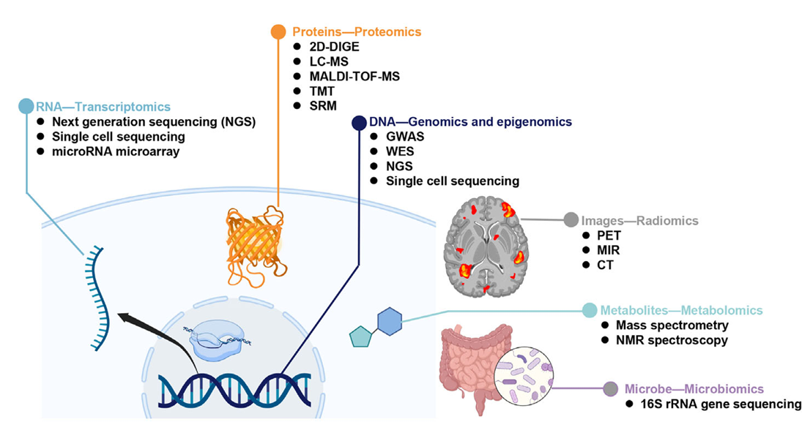
Omics

Slide 7
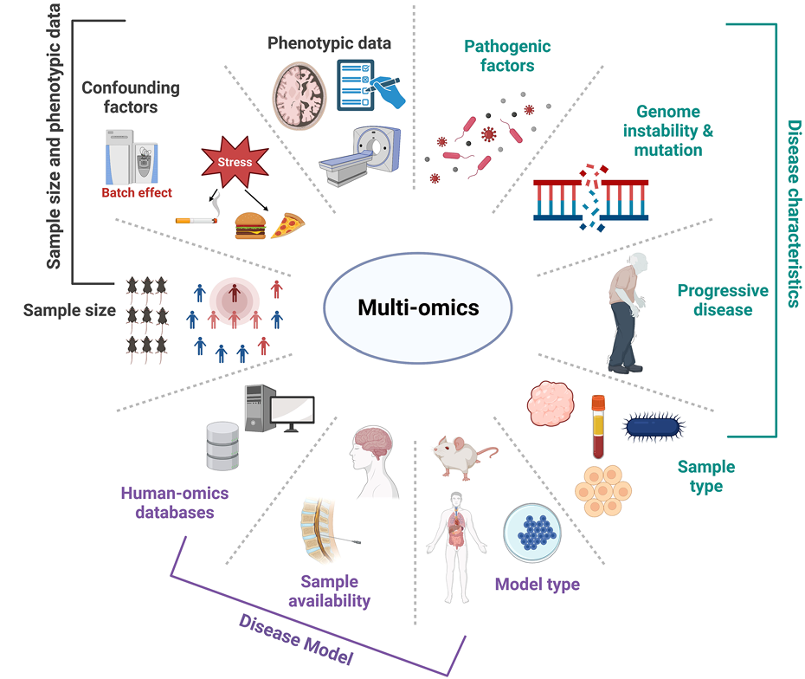
Multi-omics

Slide 8
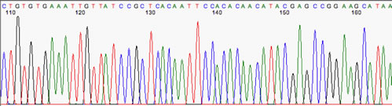
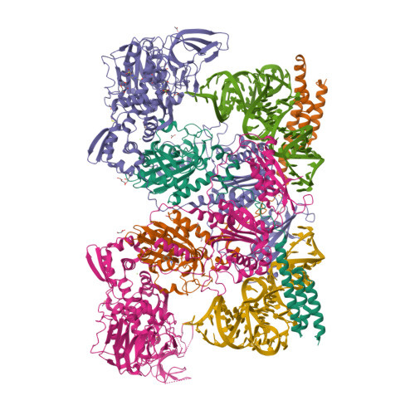
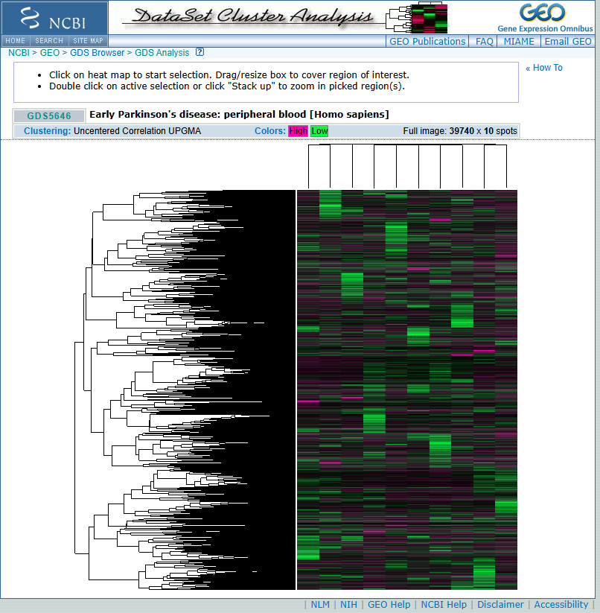
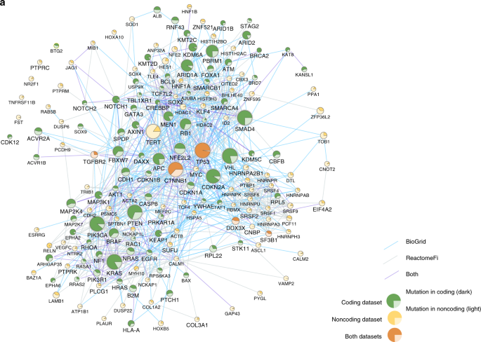
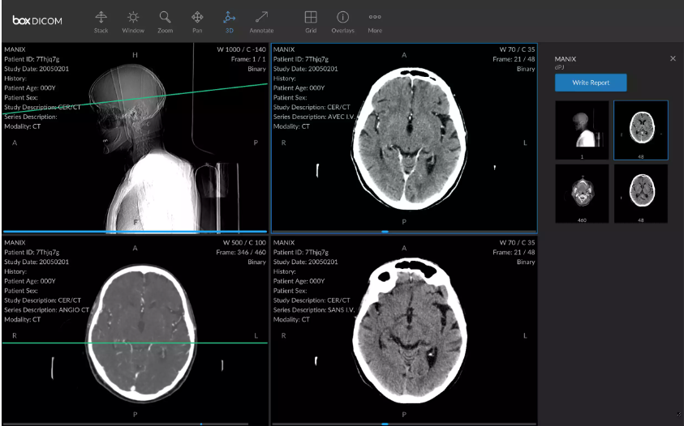
Scale of biological data
Sequence data
Structure data
Expression data
Pathway data
Image data
M. tuberculosis PheRS with tRNA and fragment complex
https://sites.biology.unt.edu/~jajohnson/Chromatogram_Interpretation

Slide 9
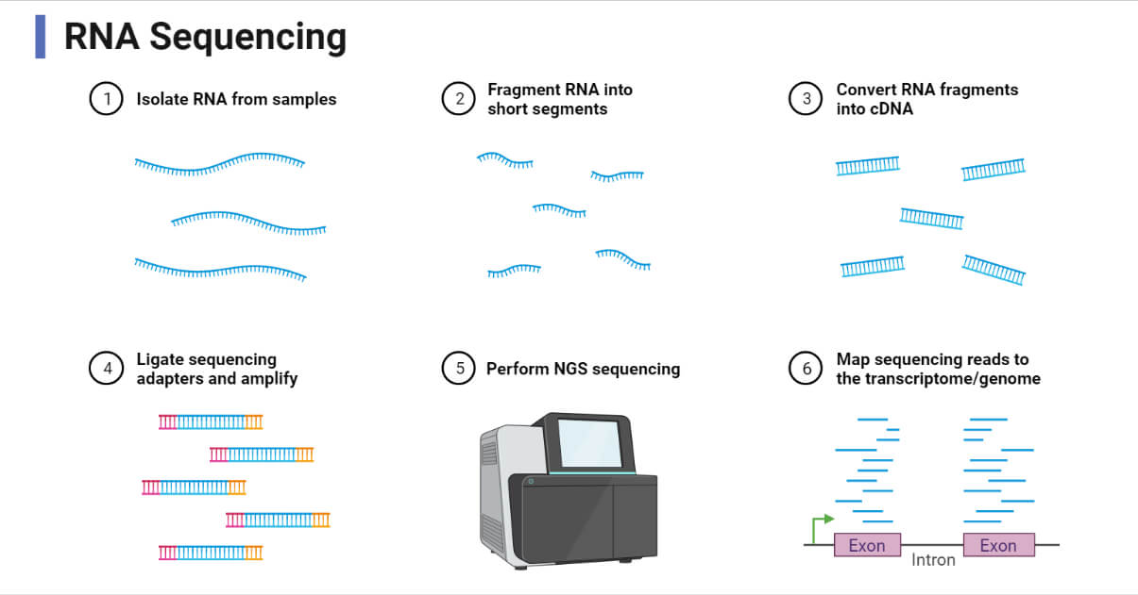
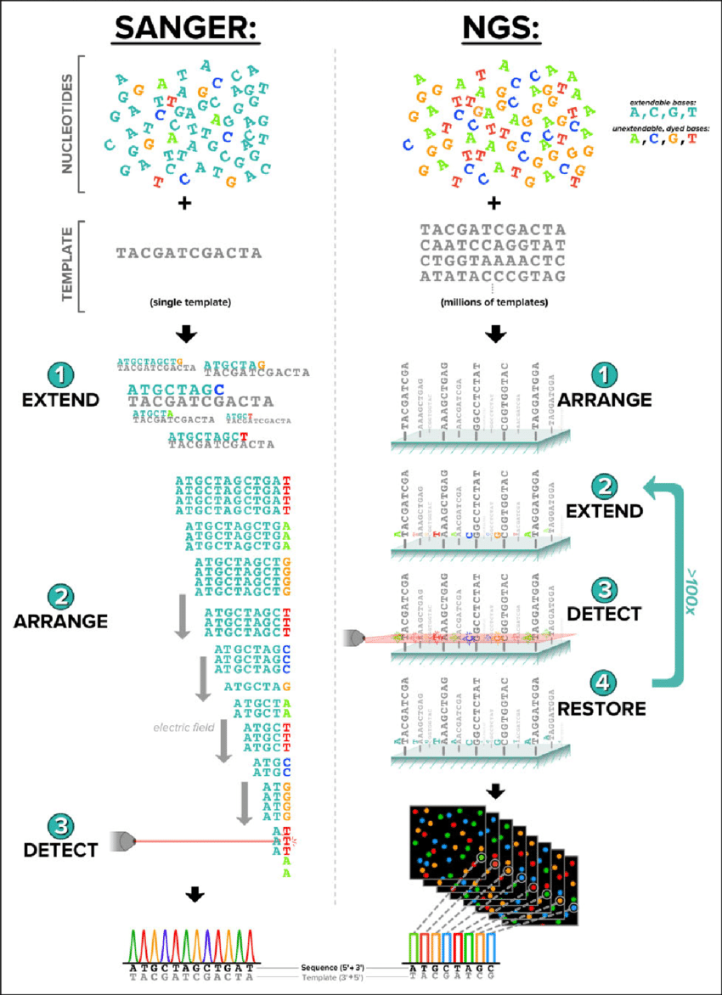
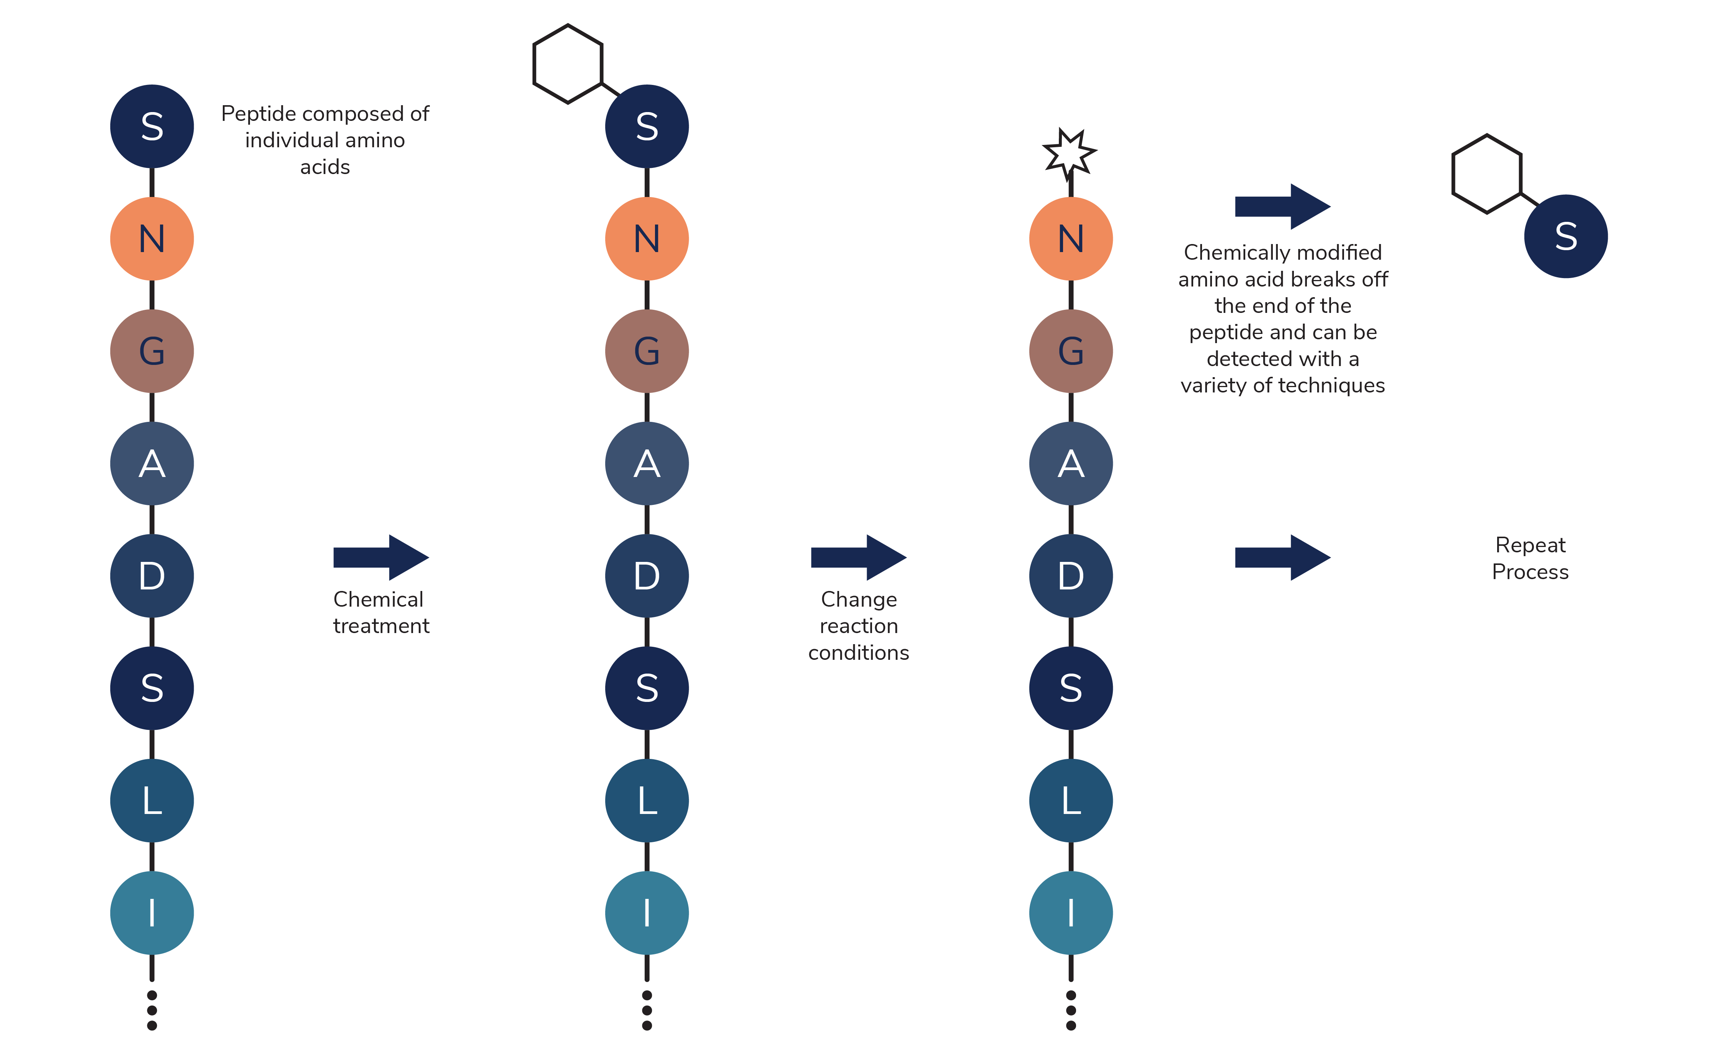
Sequence data
DNA
Maxam and Gilbert method
Semi-automated method
Automated method
Pyrosequencing
The whole-genome shotgun sequencing method
Clone by the clone sequencing method
RNA
Protein
Edmanns degradation method
https://www.genome.gov/genetics-glossary/DNA-Sequencing
https://praxilabs.com/en/blog/2021/02/08/dna-sequencing-definition-importance-methods-facts-and-more/
https://www.nautilus.bio/blog/traditional-approaches-to-study-proteins-protein-sequencing/

Slide 10
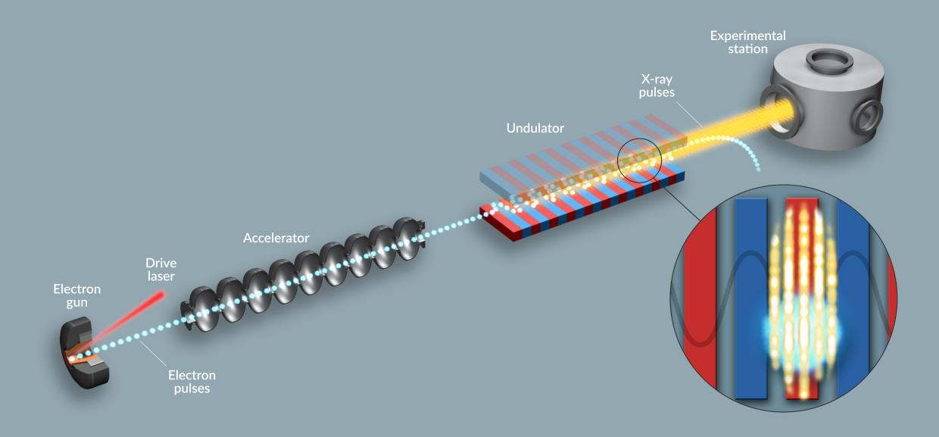
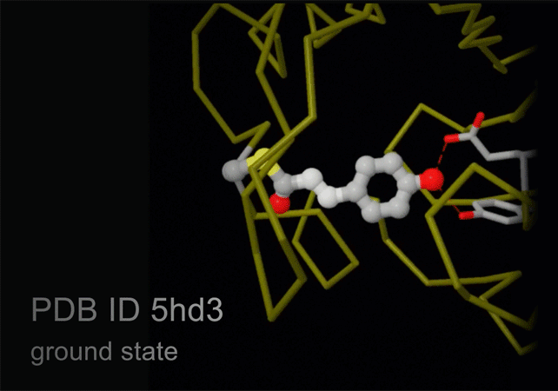
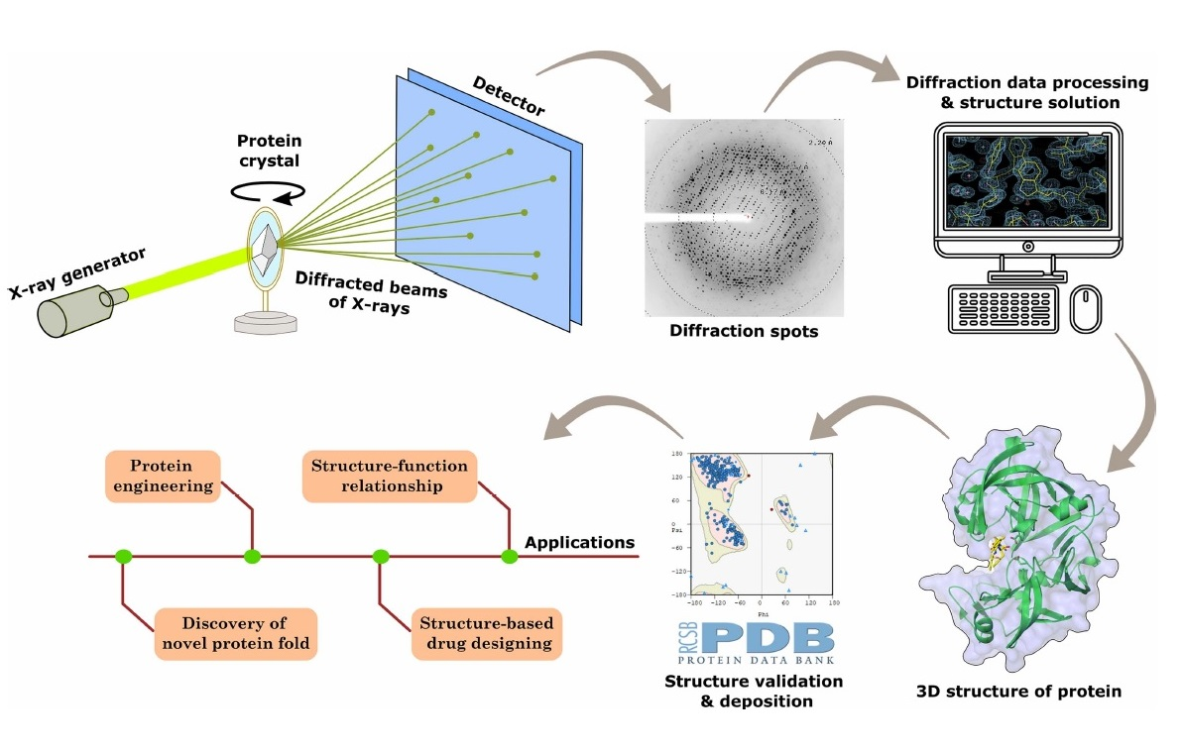
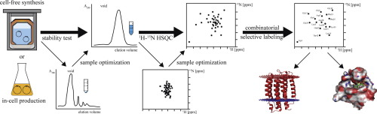
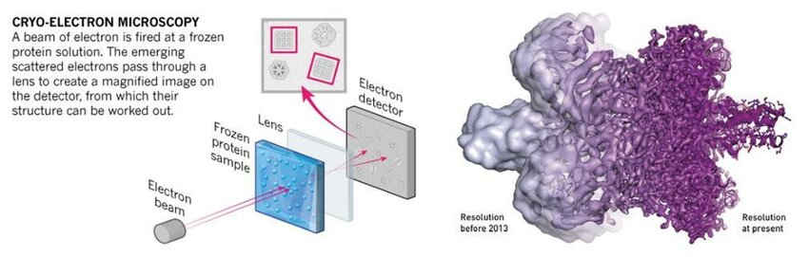
Structure data
Xray Free Electron Laser
X-ray Crystallography
NMR
https://www.bio.iitb.ac.in/~pbhaumik/
https://www.researchgate.net/publication/371470858_Prediction_of_the_molecular_structure_of_Bacillolysin_produced_by_Bacillus_thuringiensis_partial_fulfilment_of_the_requirements_for_the_degree_of_Bachelor%27s_in_Biology
https://www6.slac.stanford.edu/research/slac-science-explained/xfels
https://pdb101.rcsb.org/learn/guide-to-understanding-pdb-data/methods-for-determining-structure

Slide 11
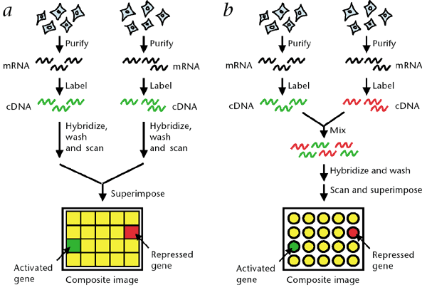
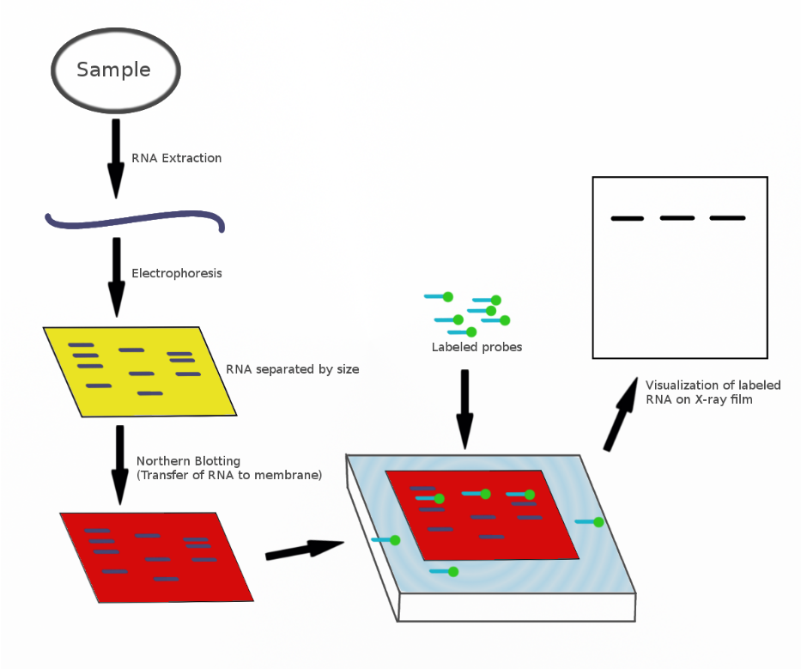
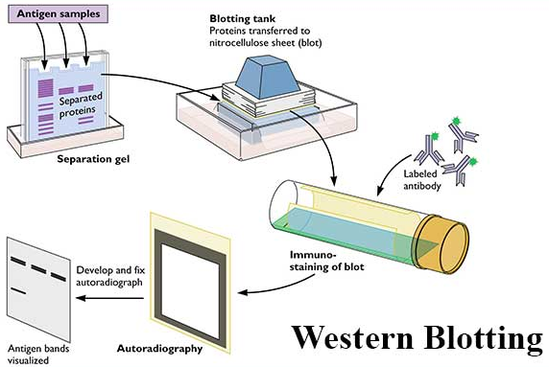
Expression data
Microarray
Northern blot
Reporter gene
Western blot
Microarray
RNA Seq
Tiling arrays
Fluorescent in situ hybridization (FISH)
Reverse transcription polymerase chain reaction (RT-PCR)
Serial Analysis of Gene Expression (SAGE)
https://en.wikipedia.org/wiki/Northern_blot
https://microbenotes.com/western-blotting-introduction-principle-and-applications/
Stears, R., Martinsky, T. & Schena, M. Trends in microarray analysis. Nat Med 9, 140–145 (2003).

Slide 12
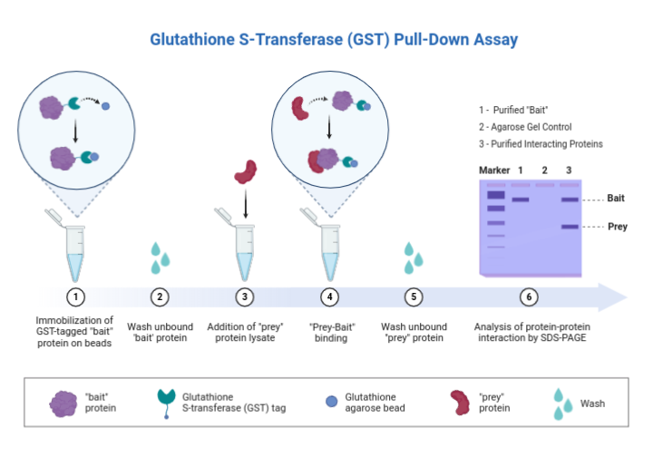
Protein - Protein Interaction studies for Pathway data
Pull-down assay
Far-western blot
EMS assay
Phage display
Biacore
Yeast-one hybrid
Yeast-two hybrid
Yeast-three hybrid

Slide 13
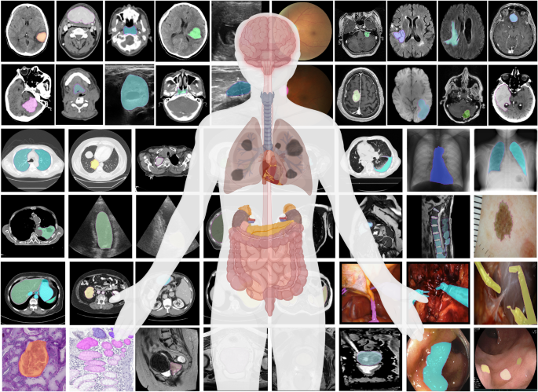
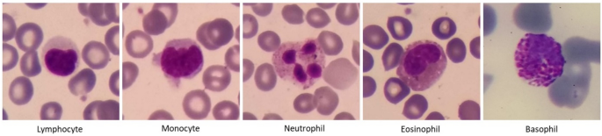
Image data
Magnetic Resonance Imaging (MRI)
Transmission Electron Microscopy (TEM)
Scanning Electron Microscopy(SEM)
Computed Tomography (CT) scan
X-ray scan
Positron Emmision Tomography
Functional Magnetic Resonance Imaging(fMRI)
Ultrasound
Ma, J., He, Y., Li, F. et al. Segment anything in medical images. Nat Commun 15, 654 (2024). https://doi.org/10.1038/s41467-024-44824-z
Kouzehkanan, Z.M., Saghari, S., Tavakoli, S. et al. A large dataset of white blood cells containing cell locations and types, along with segmented nuclei and cytoplasm. Sci Rep 12, 1123 (2022). https://doi.org/10.1038/s41598-021-04426-x

Slide 14
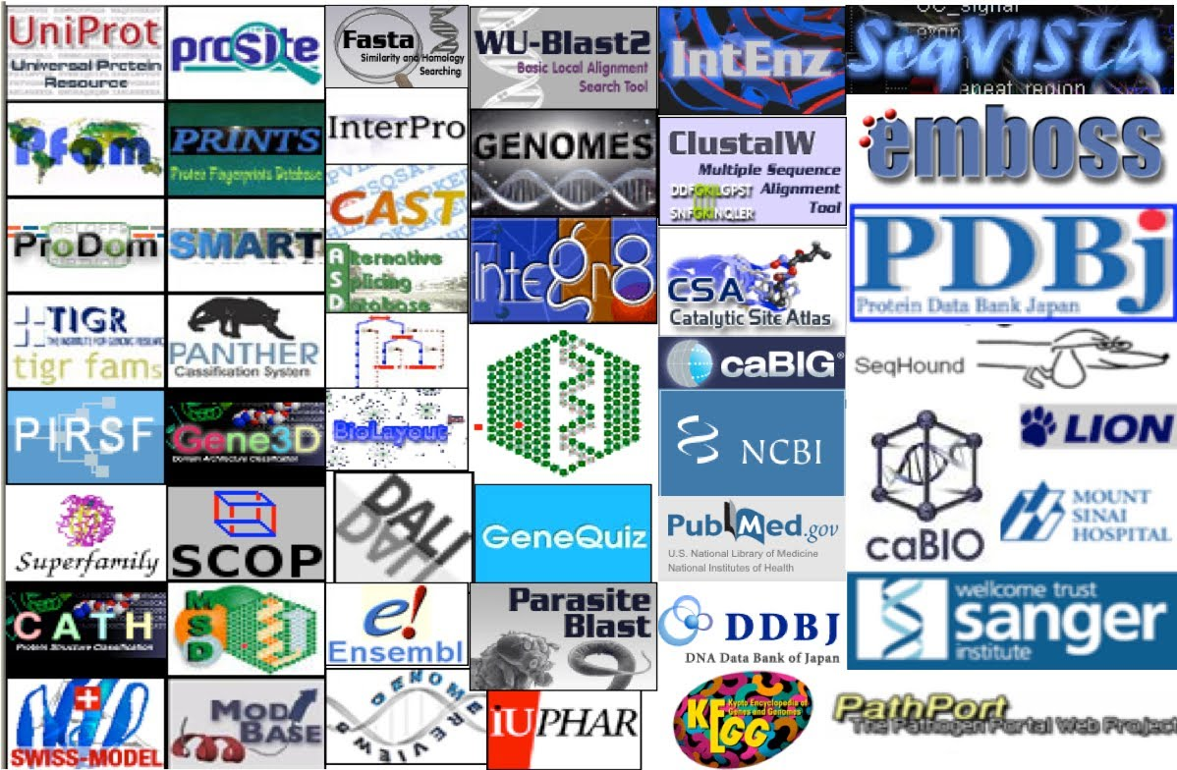
Biological data Resources
Sequence databases: NCBI, Ensembl, DDBJ
Protein databases: UniProt, PDB, InterPro
Variation databases: dbSNP, ClinVar, gnomAD
Pathway databases: KEGG, Reactome, WikiPathways

Slide 15
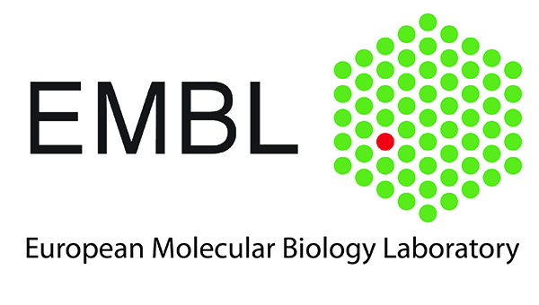
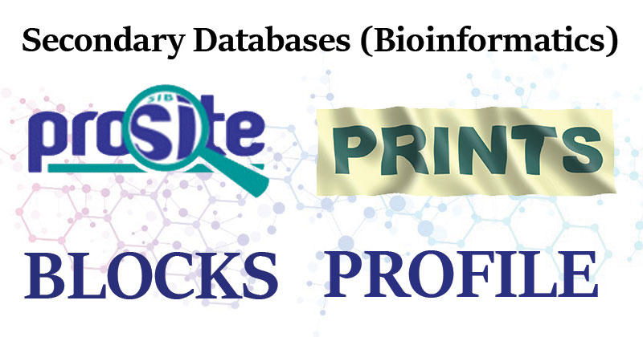
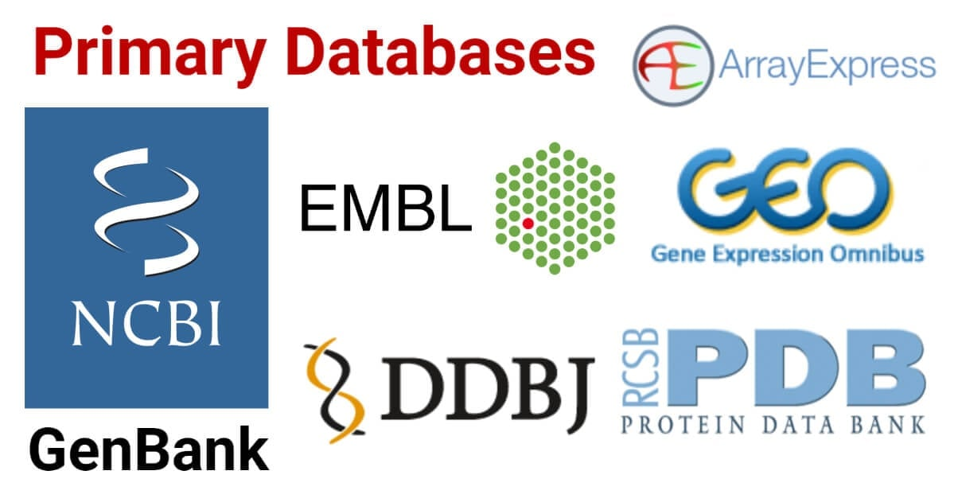

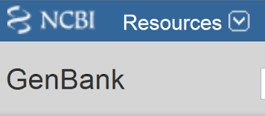






Classification
Primary
Secondary
Composite

Slide 16
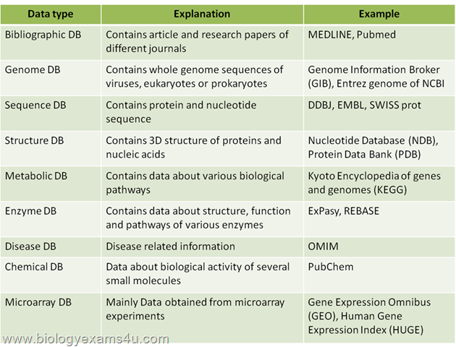
Other Classifications
https://images.app.goo.gl/HfrXFA5KwA8Ba5tJ7

Slide 17
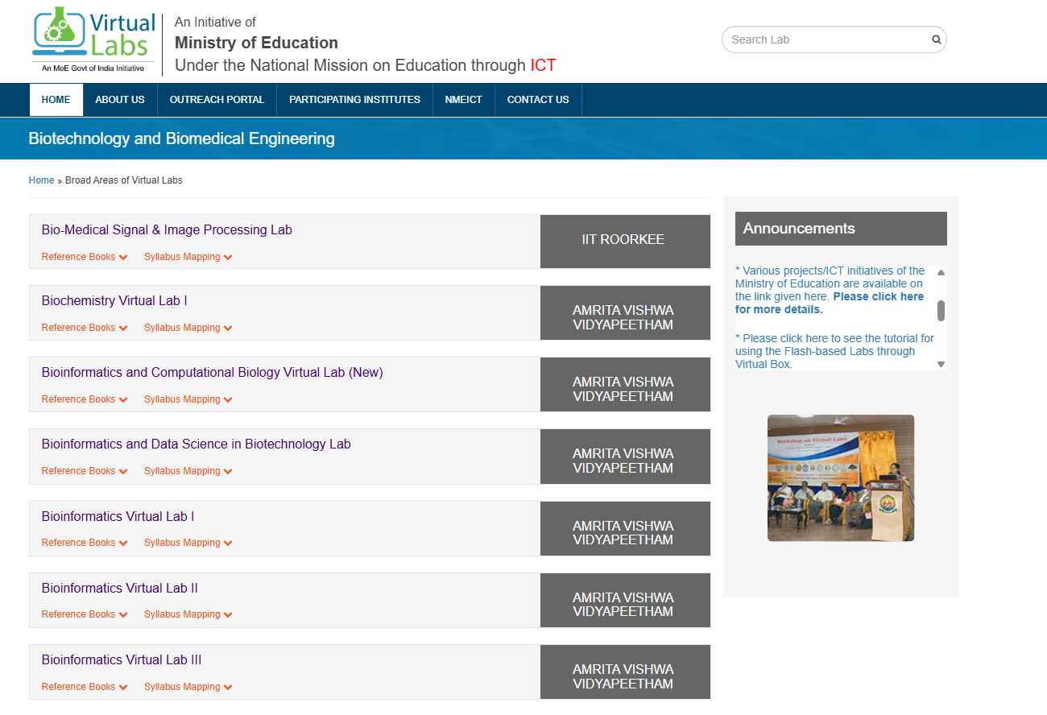
Virtual labs : An Initiative of Ministry of Education Under the National Mission on Education through ICT
https://www.vlab.co.in/

Slide 18
Data Analysis

Slide 19
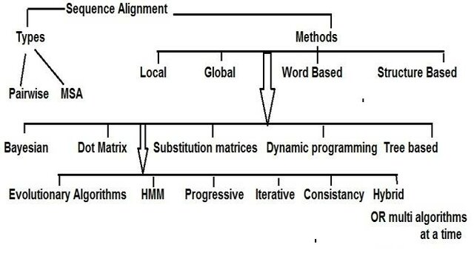
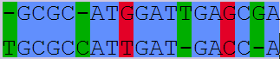
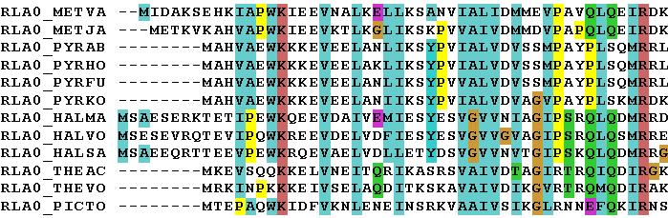
Sequence alignment
Pairwise
Multiple
https://www.researchgate.net/publication/333009225_Current_Trends_and_Ongoing_Progress_in_the_Computational_Alignment_of_Biological_Sequences

Slide 20
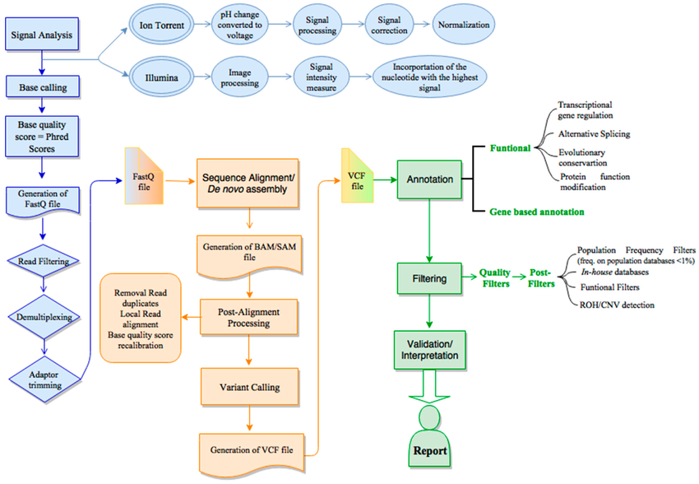
Next Generation Sequencing
https://www.researchgate.net/publication/338377445_Bioinformatics_and_Computational_Tools_for_Next-Generation_Sequencing_Analysis_in_Clinical_Genetics/figures?lo=1

Slide 21
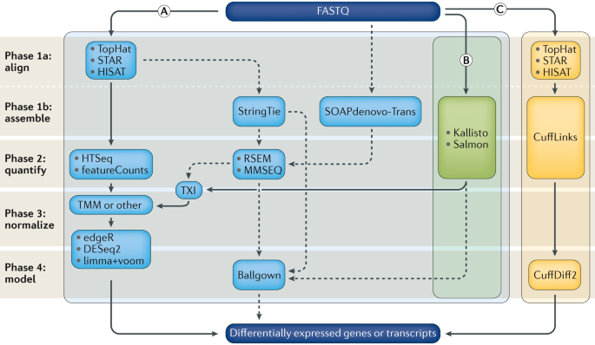
Computational analysis for differential gene expression (DGE)
Stark, R., Grzelak, M. & Hadfield, J. RNA sequencing: the teenage years. Nat Rev Genet 20, 631–656 (2019). https://doi.org/10.1038/s41576-019-0150-2

Slide 22
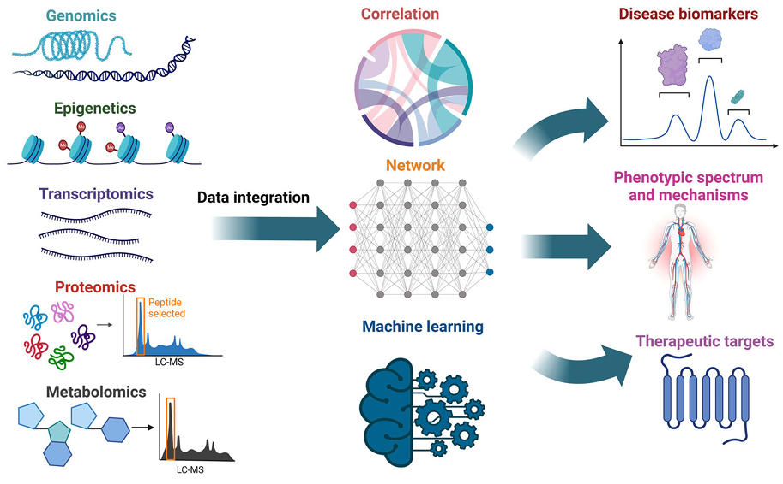
Multi-Omic Data Integration
Chen, C., Wang, J., Pan, D., Wang, X., Xu, Y., Yan, J., Wang, L., Yang, X., Yang, M., & Liu, G.-P. (2023). Applications of multi-omics analysis in human diseases. MedComm, 4(315), e315. https://doi.org/10.1002/mco2.315

Slide 23
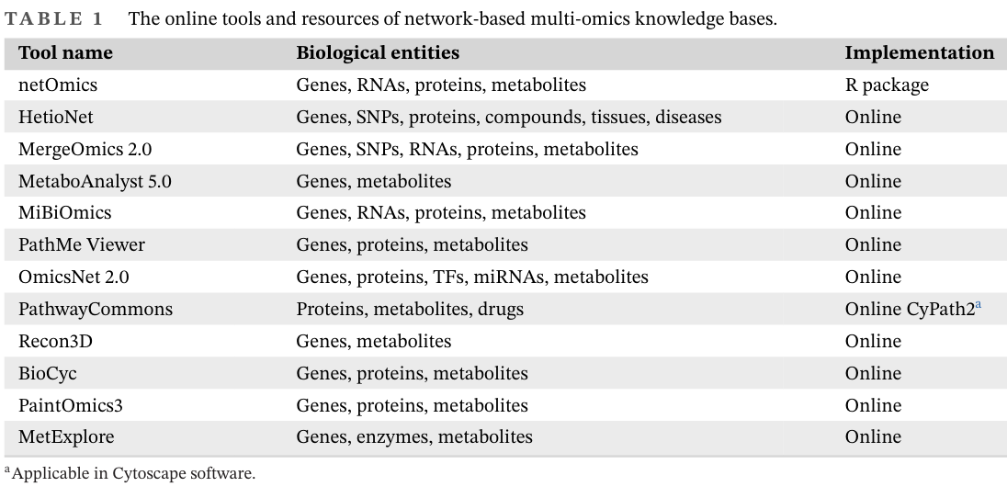
Resources on multi-omics knowledgebase
Chen, C., Wang, J., Pan, D., Wang, X., Xu, Y., Yan, J., Wang, L., Yang, X., Yang, M., & Liu, G.-P. (2023). Applications of multi-omics analysis in human diseases. MedComm, 4(315), e315. https://doi.org/10.1002/mco2.315
Zhang, X., Li, Y., & Wang, L. (2025). Applications of multi-omics analysis in human diseases. Molecular & Cellular Omics, 2(315), e315. https://doi.org/10.1002/mco2.315

Slide 24
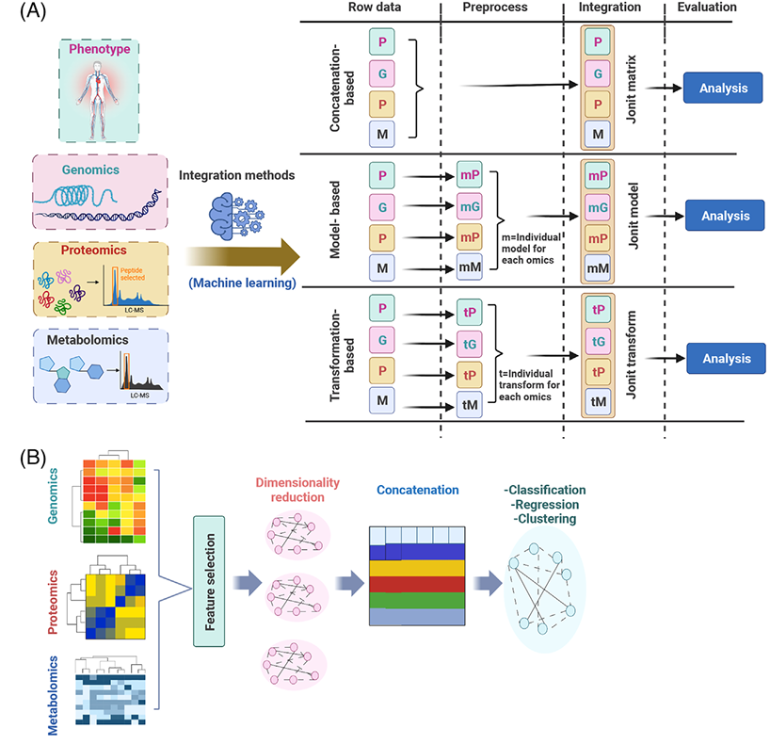
Multi-omics Integration with ML
Chen, C., Wang, J., Pan, D., Wang, X., Xu, Y., Yan, J., Wang, L., Yang, X., Yang, M., & Liu, G.-P. (2023). Applications of multi-omics analysis in human diseases. MedComm, 4(315), e315. https://doi.org/10.1002/mco2.315

Slide 25
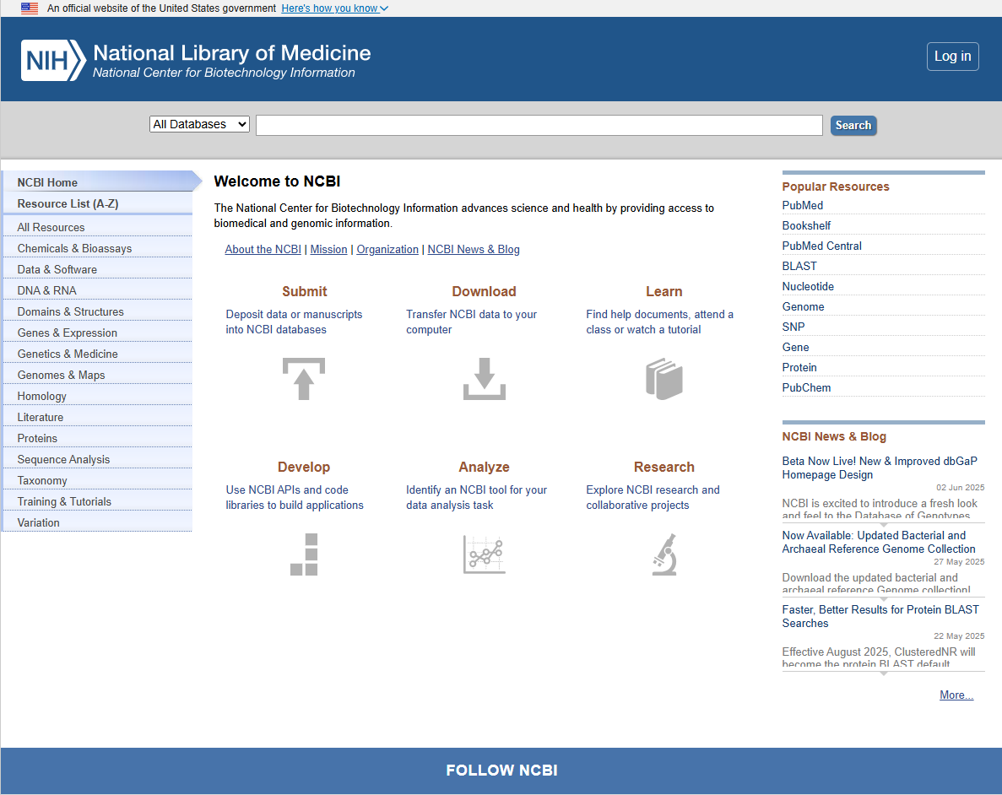
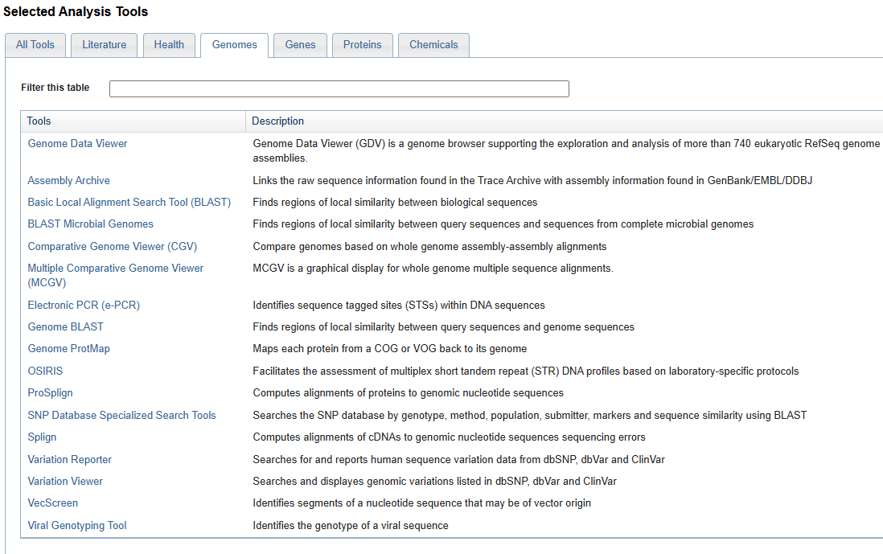
NCBI
https://www.ncbi.nlm.nih.gov/

Slide 26
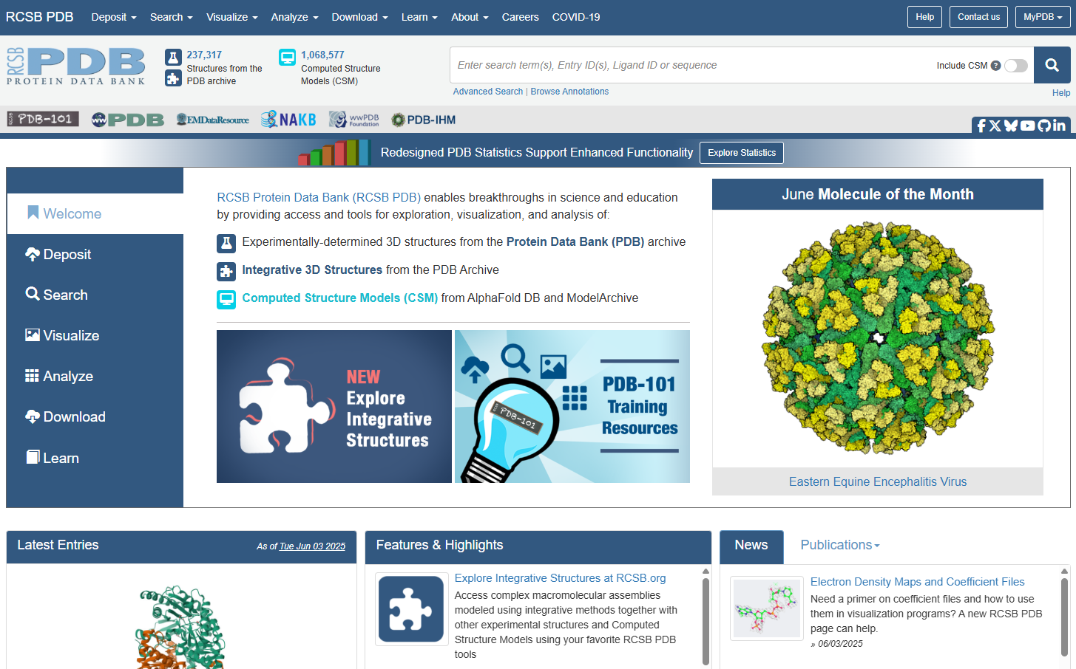
Protein Data Bank

Slide 27
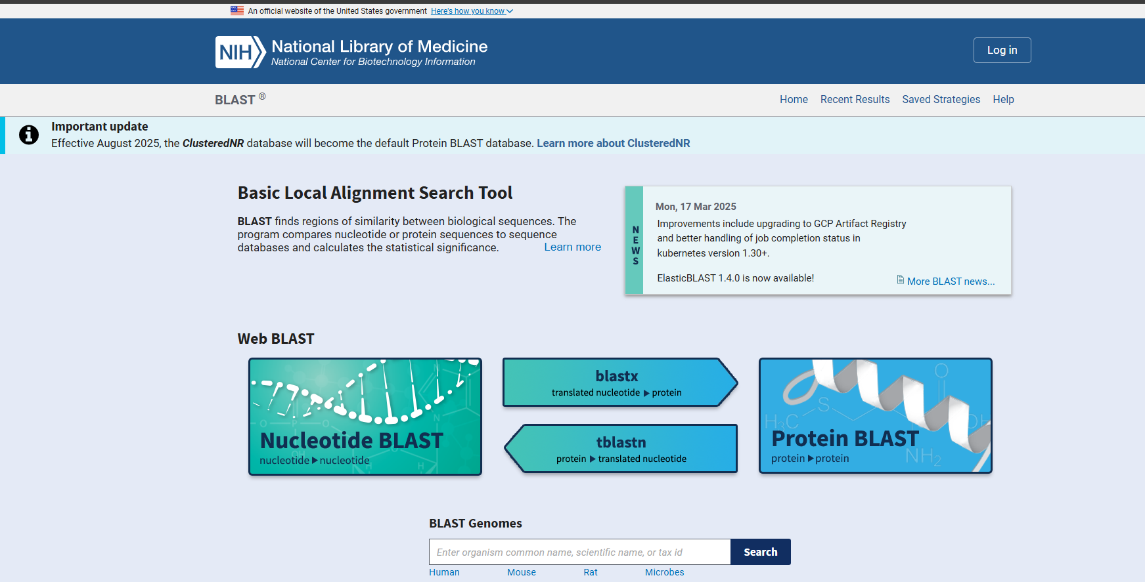
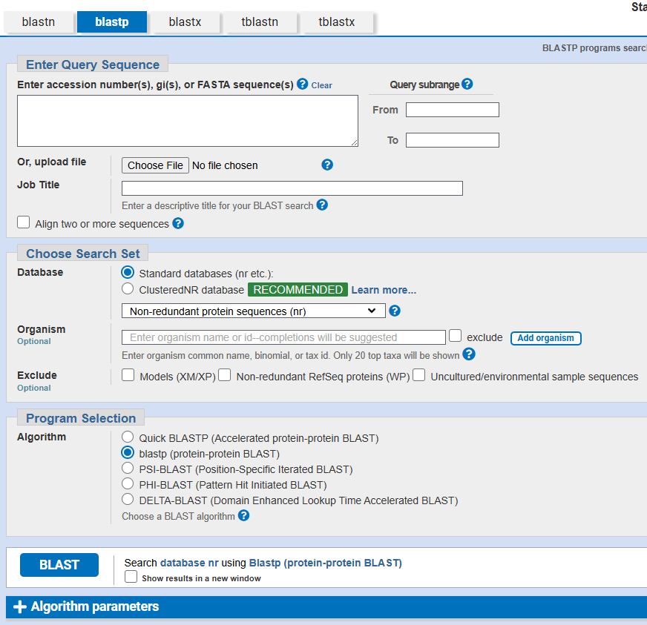
BLAST
https://blast.ncbi.nlm.nih.gov/Blast.cgi

Slide 28
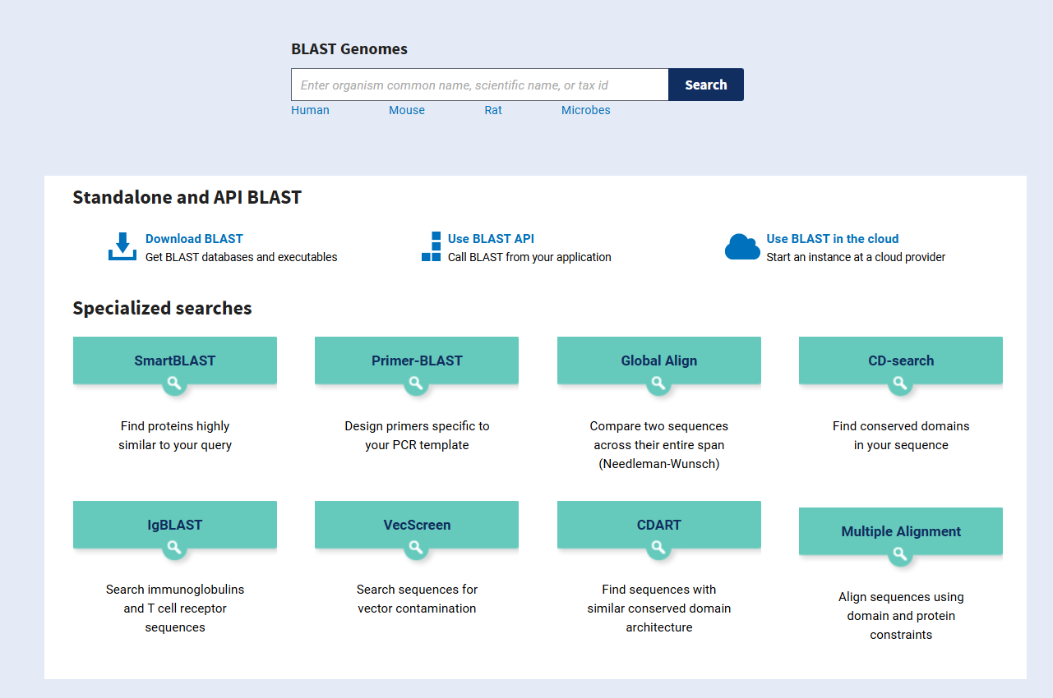
BLAST

Slide 29
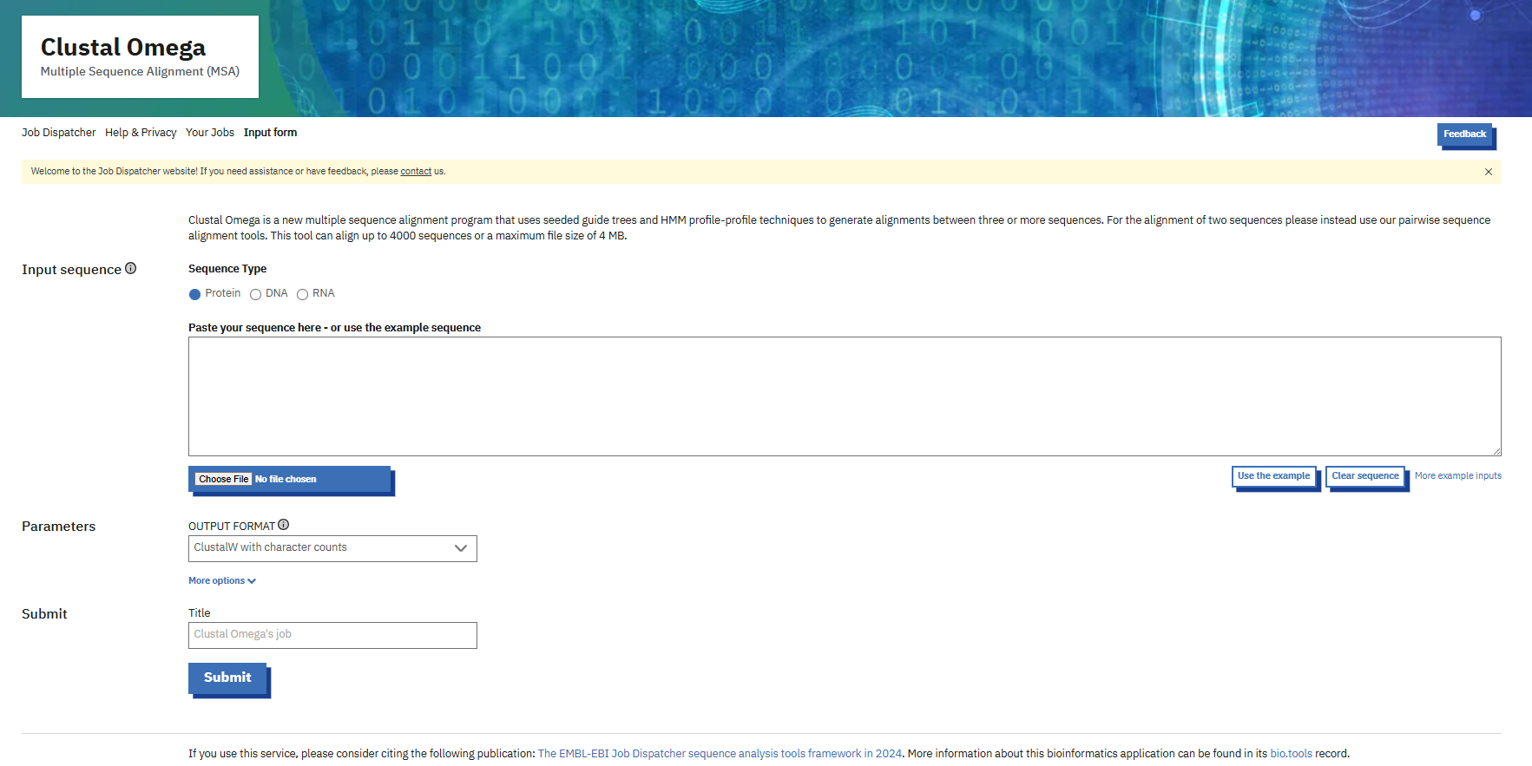
ClustalOmega

Slide 30
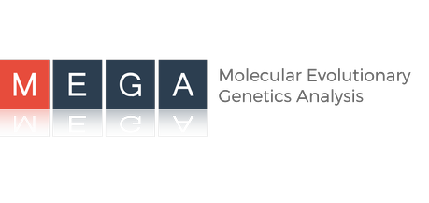






Phylogenetic tree tools
PHYLIP
PAUP*
MEGA
Dendroscope
FigTree
ggTree
MrBayes

Slide 31



RNA
https://app.biorender.com/biorender-templates/figures/5c8c7ba9d4f2ef3300632942/t-6053ac57d4322f335b02acc8-types-of-rna-produced-in-cells
https://lifeboat.com/blog/2020/09/structure-function-and-types-of-rna-mrna-trna-rrna-lncrna-mirna-sirna-snorna-snrna-pirna

Slide 32







RNA structure prediction
MFOLD
PFOLD
TFOLD
SFOLD
RNAALIFOLD
CONTRAFOLD
Vienna RNA Package
RNAstructure

Slide 33


IGV

Slide 34


Hetionet

Slide 35

Pymol

Slide 36
Thank you

